Slide 1
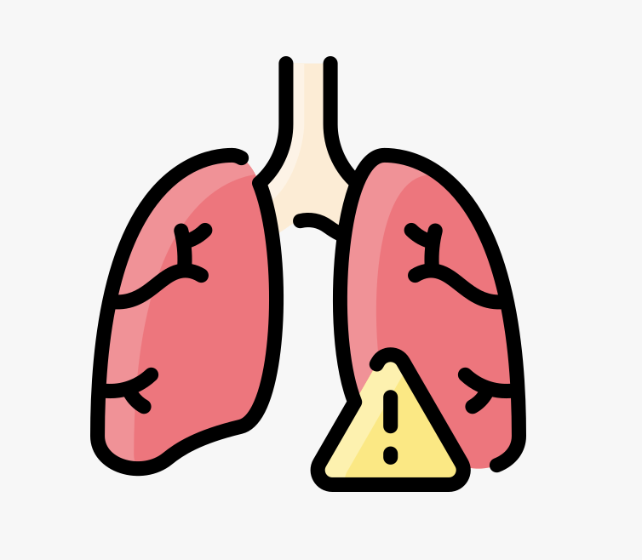
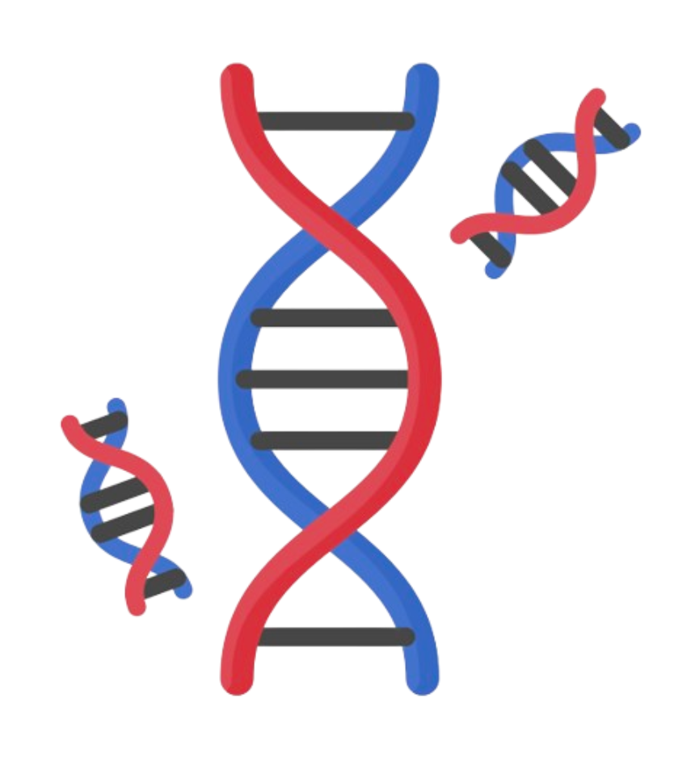
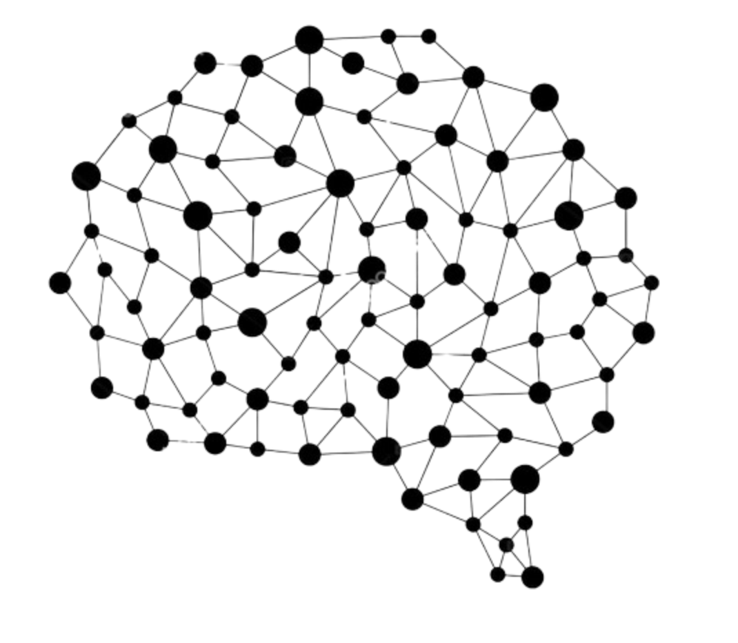
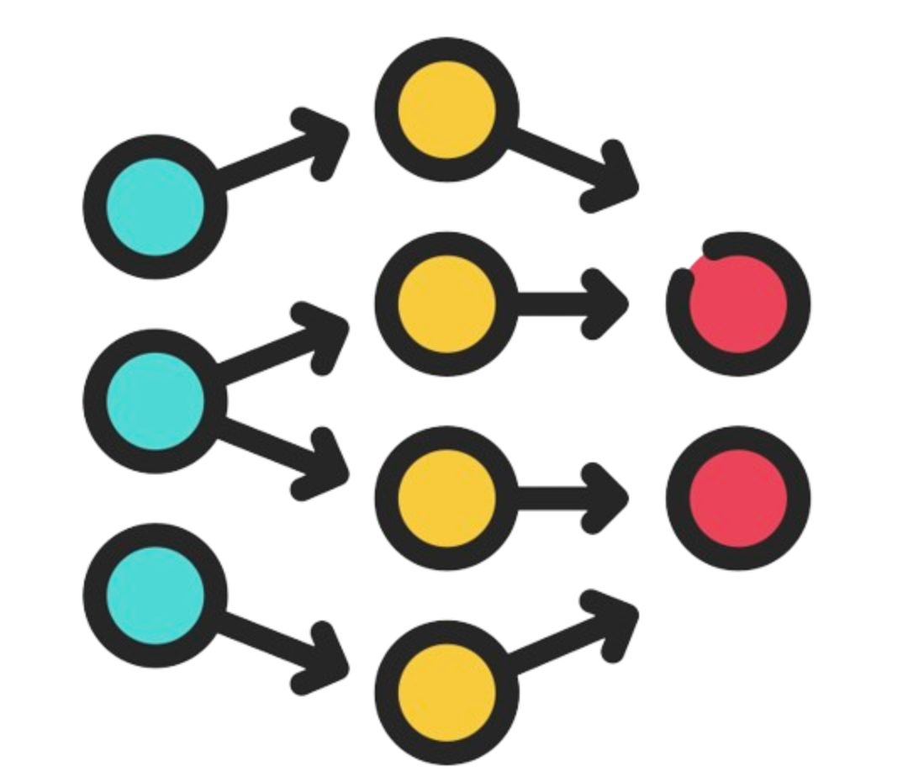
Deep learning models to predict transplant rejection using cell-free DNA fragmentomics
Supervised by Dr. Jeroen de Ridder Lucía Barbadilla Martínez
Presented by Madhupreetha V (2988291)
Notes:
I’m presenting my major research project on developing deep learning models to predict whether lung transplant recipients are experiencing rejection based on their cell-free DNA fragmentation characteristics.

Slide 2
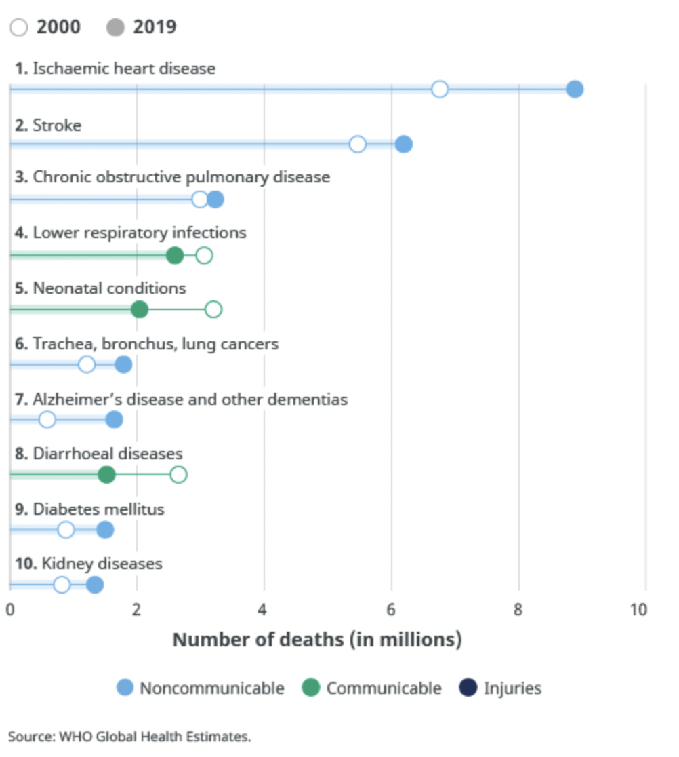
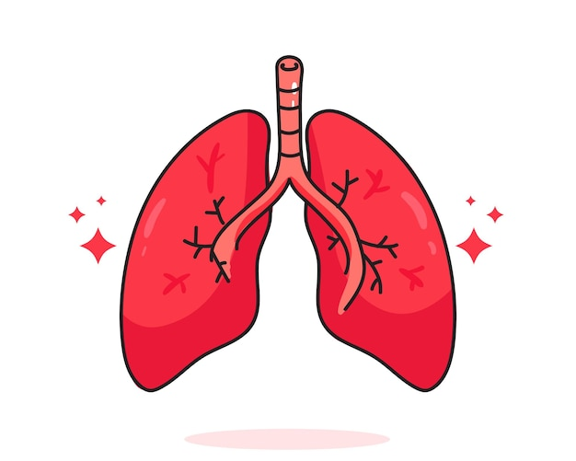

Global burden of Chronic Respiratory Diseases (CRD)
4600 lung transplants annually
Notes:
Chronic respiratory diseases are a huge burden on today;s society. According to WHO they are the third leading cause of death globally, with over 4 million annual deaths. Lung transplant is the last resort treatment option for these patients. Over 4600 lung transplants are perfomed every year in the world. But, only a little over half of these transplant recipients are alive 5 years after their transplant

Slide 3
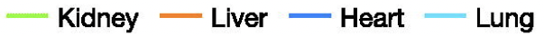
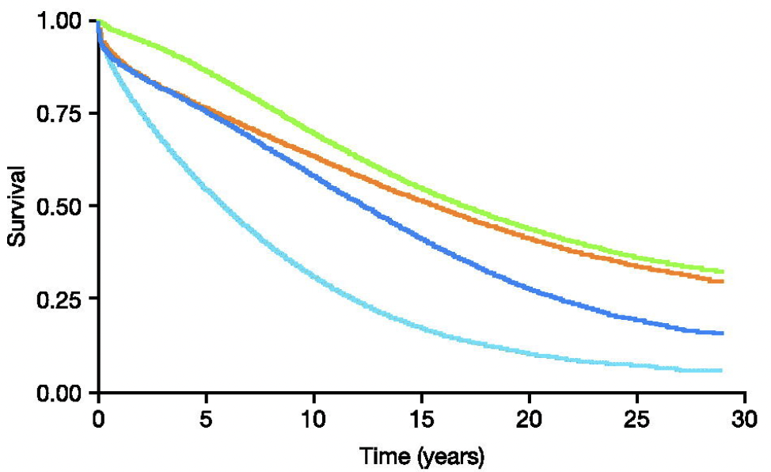
Lung transplants have poor long-term outcomes
The mean 5-year survival rate is 58% An average transplant recipient lives for just a little over 5 years
Graham, C.N. et al., 2022. Mean lifetime survival estimates following solid organ transplantation in the US and UK. Journal of Medical Economics, 25(1), pp.230-237.
Notes:
Lung transplant has the poorest long term survival outcomes, compared to all types of transplants. The survival rate after 5 years is a just 58%. In other words, an average lung transplant recipients lives for just a little over 5 years after transplant, the lowest among all types of transplants, even heart

Slide 4
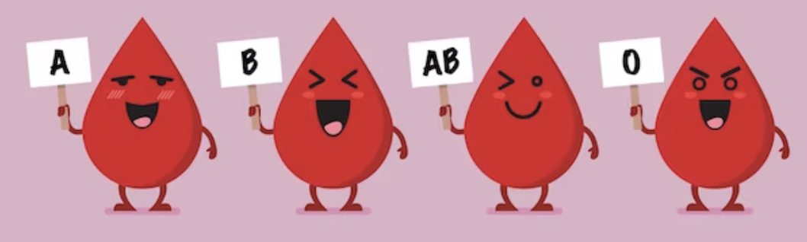
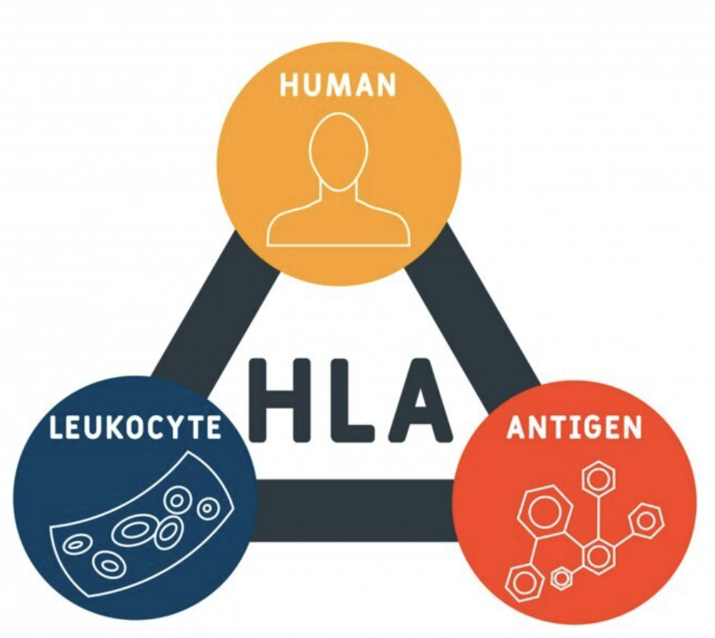
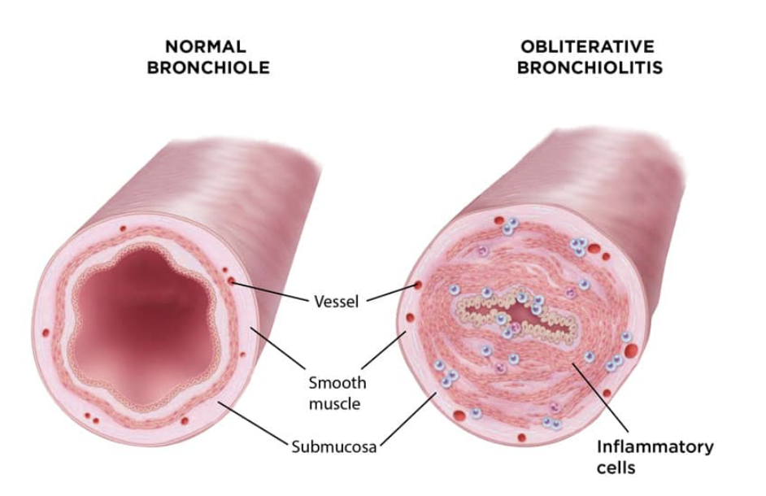
Chronic rejection – Bronchitis Obliterans Syndrome
Acute
Chronic
Belperio, J.A. et al., 2009. Chronic lung allograft rejection: mechanisms and therapy. Proceedings of the American Thoracic Society, 6(1), pp.108-121.
Notes:
This is the case due to transplant rejections. Rejections can be chronic or acute. Acute rejections is what usually we are familiar with – where the recipient’s immune system detects HLA and blood group associated antigens on the transplanted organ as foreign and launches an immune attack, damaging the organ in the process. We can mitigate this to some extent by HLA and blood group matching. The other form of rejection, chronic rejection occurs over months or years post transplant. Not much is known about this type of rejection. We only know that acute rejection episodes are a risk factor. Lung transplants have the highest incidence of chronic rejection. This leads to inflammation of the lung bronchiole. The lung capacity is progressively reduced and eventually this results in the death of the patient.

Slide 5
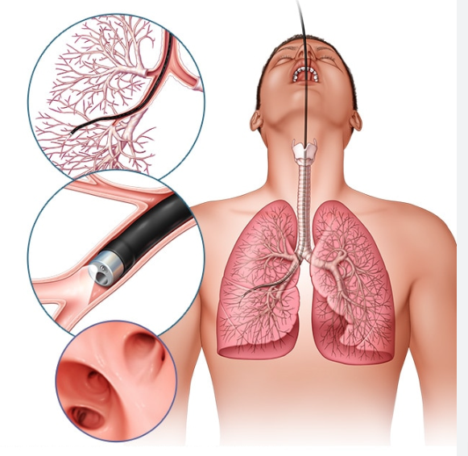
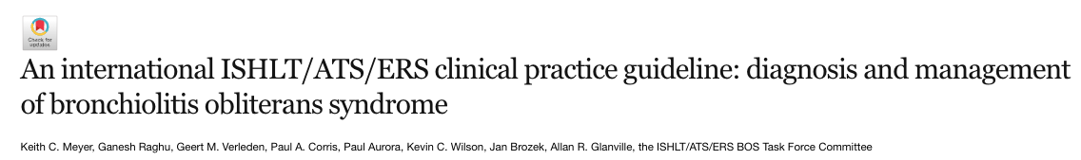
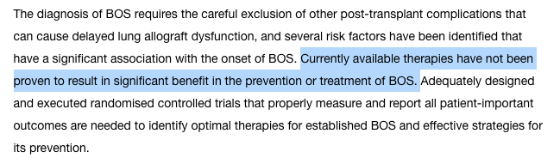
Transbronchial biopsy and histopathological studies
Often too late when chronic rejection is diagnosed
Transbronchial biopsy
Meyer, K.C. et al., 2014. An international ISHLT/ATS/ERS clinical practice guideline: diagnosis and management of bronchiolitis obliterans syndrome. pp.1479-1503.
Notes:
The current gold standard for rejection diagnosis is transbronchial biopsy. In invasive and clearly painful process, the doctor pushes forceps through the nostrils, airways and to the bronchioles and a sample of lung tissue is taken for studying. This is clearly an invasive and painful experience for the patients. In some cases it has also been shown to be potentially dangerous to the patient, increasing the risk of other dieases.

Slide 6

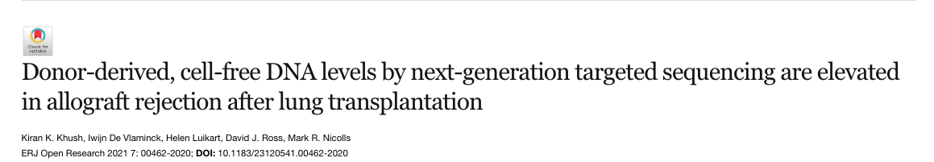

Donor-derived cell-free DNA for rejection diagnosis
Non-invasive, cost-effective and EARLY detection of rejection
Rejection diagnosis could be a simple blood test !
Khush, Kiran K., et al. "Donor-derived, cell-free DNA levels by next-generation targeted sequencing are elevated in allograft rejection after lung transplantation." ERJ Open Research 7.1 (2021).
Notes:
Many studies have found that the levels of cell-fee DNA that originate from the transplanted lung, aka donor-derived cell-free DNA are higher during rejections than healthy transplant cases. If we can measure the elevls of this donor-derived cell-free DNA, we could diagnose whether the patient is having a rejection. Not only that, studies have also found that the levels are increased much before the actual clinical symptoms for BO S appear, gicing us an early detection method.

Slide 7
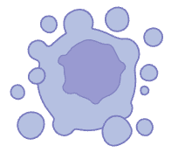
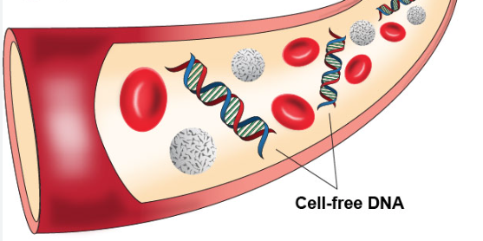
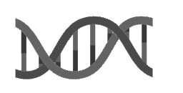
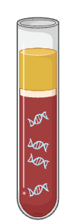
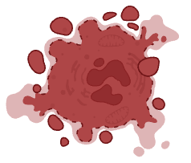

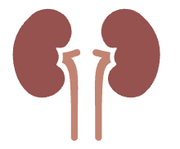


What is cell-free DNA (cfDNA)
Apoptosis
Circulating tumor DNA
Necrosis
Organ transplant
Cell-free DNA
Secretion
Mouliere, Florent. "A hitchhiker’s guide to cell-free DNA biology." Neuro-oncology advances 4.Supplement_2 (2022): ii6-ii14.
Source unknown
Notes:
Stepping back, what exactly is cell-free DNA ? Small DNA fragments that are floating around in the blood. They are released from dying blood cells during processes like apoptosis, necrosis or active secretion. In addition to it, injured cells also release cell-free DNA into the cell-free DNA pool. Tumours for example, are known to release cell-free DNA into the blood, which have been used to successfully diagnose cancer. Similarly, after organ transplant, due to initial minor rejections, the transplanted organ releases it’s cell-free DNA into the recipient’s blood. This Is termed the donor-derived or dd-cfDNA.

Slide 8


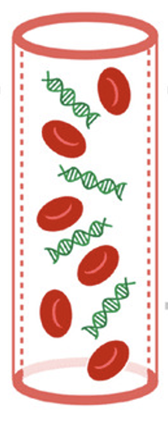




Elevated dd-cfDNA during rejections
Normal levels of donor-derived cell-free DNA (dd-cfDNA)
Healthy transplant
Elevated levels of donor-derived cell-free DNA (dd-cfDNA)
Transplant rejection
Sourced from Paul, Rohan S., et al., 2021
How do you differentiate between donor-derived and recipient-derived cfDNA ?

Slide 9


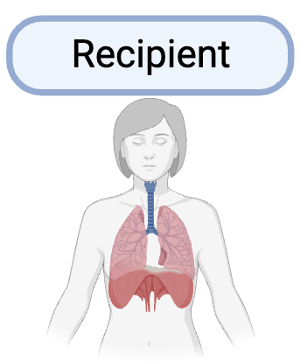
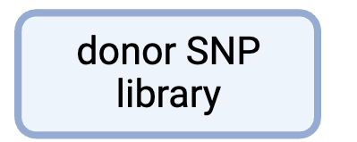
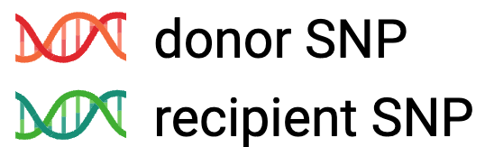
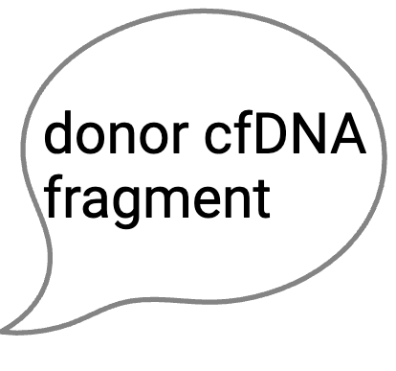
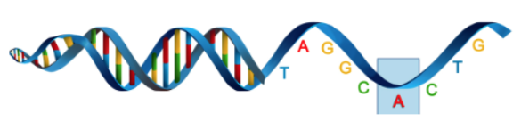
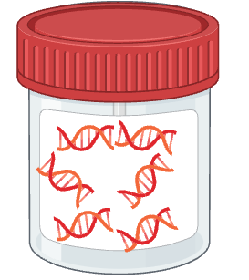
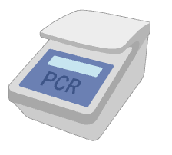

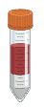

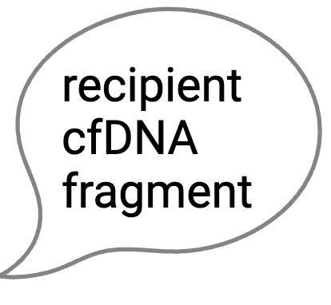
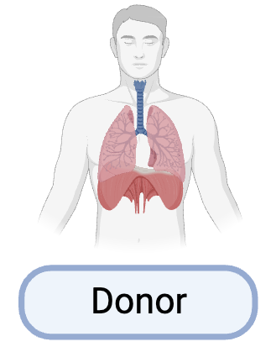
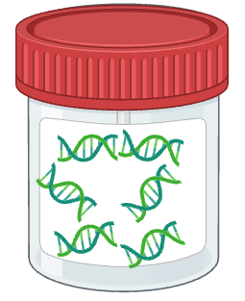

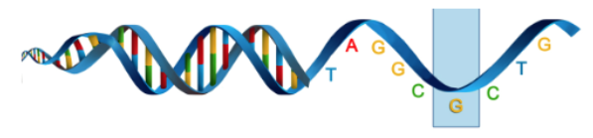

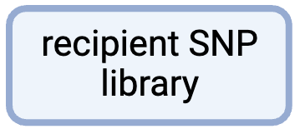
SNP-based dd-cfDNA quantification
SNP genotyping of donor and recipient
Selective amplification and quantification
Keller, Michael, and Sean Agbor-Enoh. "Donor-derived cell-free DNA for acute rejection monitoring in heart and lung transplantation." Current Transplantation Reports 8.4 (2021): 351-358.

Slide 10




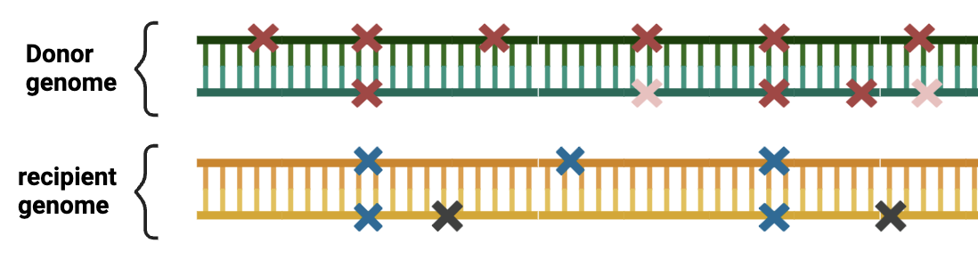



SNP genotyping pitfalls
Donor
Donor genotype is usually not available
SNPs that are different between donors and recipients, how many of them become cfDNA
Genotyping is expensive
Keller, Michael, and Sean Agbor-Enoh. "Donor-derived cell-free DNA for acute rejection monitoring in heart and lung transplantation." Current Transplantation Reports 8.4 (2021): 351-358.

Slide 11
We need a method to distinguish between dd-cfDNA and rd-cfDNA that does not involve SNP genotyping

Slide 12

Deep Learning
A Deep Learning model to classify between dd-cfDNA and rd-cfDNA
Classification based on tissue of origin
recipient-derived cfDNA
donor-derived cfDNA
Isn’t the DNA sequence the same for all tissue types – blood or lung ?
Lui, Yanni YN, et al. "Predominant hematopoietic origin of cell-free DNA in plasma and serum after sex-mismatched bone marrow transplantation." Clinical chemistry 48.3 (2002): 421-427.
Notes:
Complex task where we need predictive accuracy. So we turn to Deep learning.

Slide 13



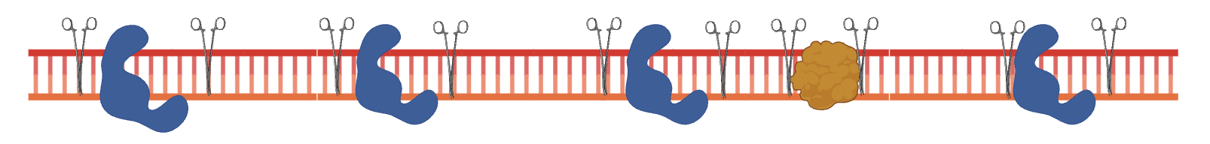

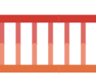


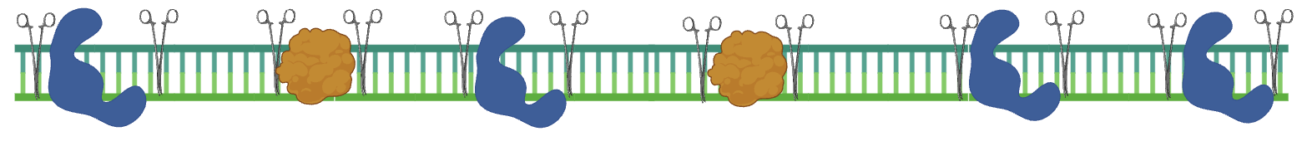
cfDNA fragmentomics !
Nucleosome
Transcription factor
Lung cell DNA
Blood cell DNA
Lung and blood cell derived cfDNA fragments originate from different genomic regions !
Snyder, Matthew W., et al. "Cell-free DNA comprises an in vivo nucleosome footprint that informs its tissues-of-origin." Cell 164.1 (2016): 57-68.

Slide 14

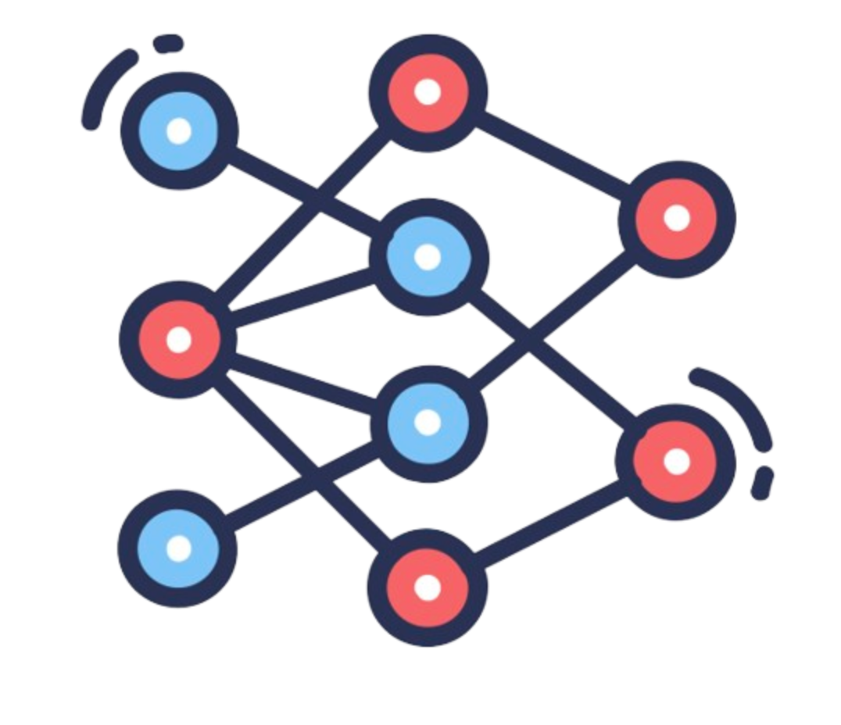
1. Epigenetic characteristics as features
chromatin structure
DNA accessibility
Epigenetic modifications
Transcription factor binding sites
ENFORMER
Genomic regions differ in
DNA accessibility
ATAC-seq
CAGE-seq
CHIP-seq
5,313 cell-type specific epigenetic tracks
Avsec, Žiga, et al. "Effective gene expression prediction from sequence by integrating long-range interactions." Nature methods 18.10 (2021): 1196-1203.

Slide 15
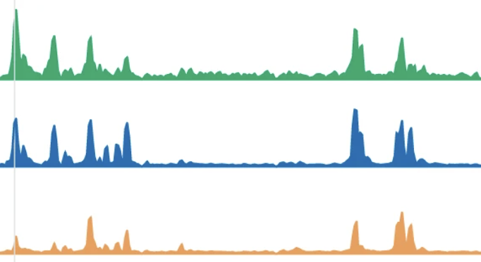

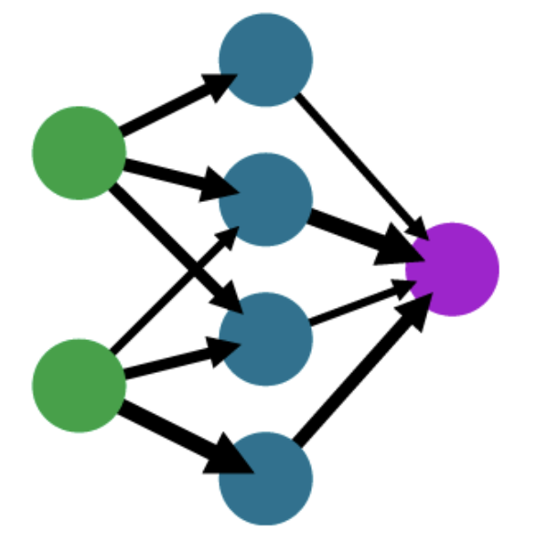
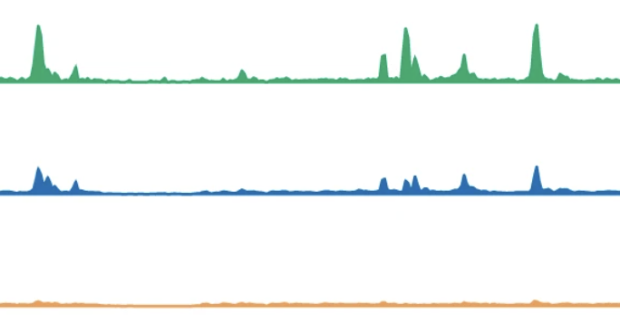
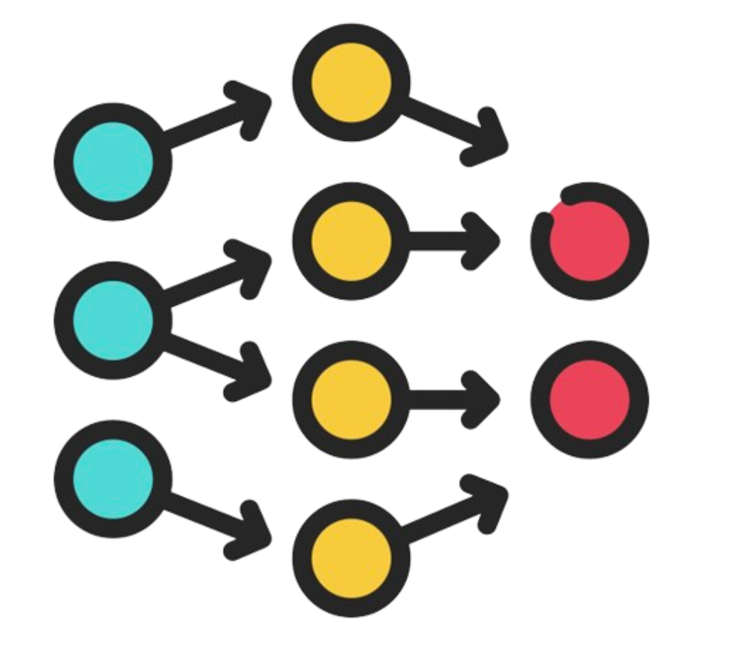
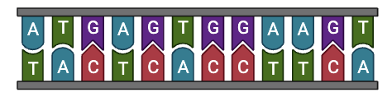

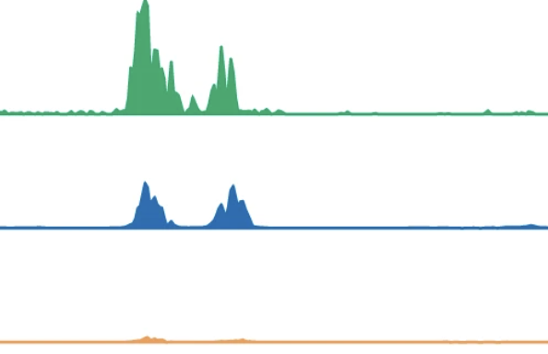

Training dense layer
Donor-derived
Enformer
Recipient-derived
5,313 epigenetic cell-type specific epigenetic tracks

Slide 16


2. Sequence motifs as features
SEQUENCE MOTIFS
Convolutional filters
Lanchantin, Jack, et al. "Deep motif dashboard: visualizing and understanding genomic sequences using deep neural networks." Pacific Symposium on Biocomputing 2017. 2017.

Slide 17
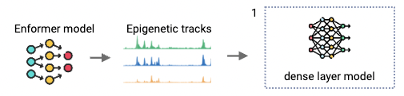
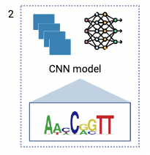
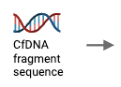
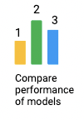


Slide 18








The data
Donor- derived
SNP genotyping
0
250
1500
500
750
recipient- derived
Each patient
47 lung transplant recipients
Raw cfDNA fragment sequence various days post transplant
De Vlaminck, Iwijn, et al. "Noninvasive monitoring of infection and rejection after lung transplantation." Proceedings of the National Academy of Sciences 112.43 (2015): 13336-13341.
Notes:
Data is imbalanced, downsampled
Split into training, validation and test sets

Slide 19



WORKFLOW
Training
Down sampling
Validation
0
250
1500
500
750
Healthy transplant
Test set
cfDNA fragment sequence over various days post transplant
% dd-cfDNA
Deep learning classifier
Transplant rejection

Slide 20
RESULTS

Slide 21



Initial data analysis – PCA and t-SNE
PCA plot of all blood and lung cell type epigenetic tracks
PCA plot of all Enformer-generated epigenetic tracks
T-SNE plot of all Enformer-generated epigenetic tracks

Slide 22


Feed forward neural network (Enformer epigenetic tracks) results
donor
NOT ANY BETTER THAN A RANDOM CLASSIFIER
recipient
AUC Training: 0.51 Validation: 0.50
donor
recipient

Slide 23
Learning rate optimization did not improve performance
Notes:
Highest AUC we reached was on the validation set – 0.504, again not much better than a random classifier

Slide 24


Other hyperparameter optimization attempts
Cosine annealing
# of hidden layers
Loss function
Optimizer
Feature selection

Slide 25



Back to the drawing board - Simulations
Generate synthetic data of random numbers
Enformer features
Samples

Slide 26


Back to the drawing board - Simulations
Add signal to donor-derived fragment class
Enformer features
Samples

Slide 27

Back to the drawing board - Simulations
Add signal to donor-derived fragment class
Enformer features
Samples

Slide 28


Back to the drawing board - Simulations
Add different signal to recipient-derived fragment class
Enformer features
Samples

Slide 29

Results from simulations

Slide 30

What can we conclude from the simulations
There are no flaws in the training methodology
The real data is noisy – many samples don’t have any meaningful signals for classification
Simulation is an oversimplification of the signals in the real data. Extrapolation of inferences from simulations to real data should be done with caution
Notes:
We consistently add the same signal at the same features. In the real data, we expect a composite combination of features to have signals in each sample.

Slide 31

CNN results
Training
Training
Learning rates
donor
donor
Dropout layers
Weight decays
recipient
recipient
Model architecture
donor
recipient
donor
recipient
Validation AUC: 0.524

Slide 32
Comparison of model performances

Slide 33





Aggregate predictions – patient-level results
Notes:
Now we have something that classifies on a per-fragment level. But the final % dd-cfDNA levels are calculated on a patient level. So we aggregated the fragment-level predictions for test patients and compared it to the % dd-cfDNA levels from true labels.

Slide 34







Data problems?
Notes:
That brings us to the conclusions . Study after study has shown

Slide 35
CONCLUSIONS AND DISCUSSION

Slide 36


Are lung and blood cells that different ?
Li, Shuxiang, Yunhui Peng, and Anna R. Panchenko, 2022., Jiang, Cizhong, and B. Franklin Pugh, 2009., Chen, Taiping, and Sharon YR Dent, 2014
Snyder, Matthew W., et al. "Cell-free DNA comprises an in vivo nucleosome footprint that informs its tissues-of-origin." Cell 164.1 (2016): 57-68.

Slide 37
Potential problems
Future prospects
Different dataset
Fragment overlap ?
Fragments from DHS sites
Incomplete hyperparameter optimization ?
Re-labelling SNPs
Insufficient training data ?
Pre-training the model
Randomized grid search
Snyder, Matthew W., et al. "Cell-free DNA comprises an in vivo nucleosome footprint that informs its tissues-of-origin." Cell 164.1 (2016): 57-68.

Slide 38


A lot of promise
Fetal chromosomal aberrations
Cancer

Slide 39


Slide 40

Thank you, de Ridder group : )
Special thanks to Dr. Jeroen de Ridder Lucía Barbadilla Martínez Li-Ting Chen Marc Pagès-Gallego Dieter Stoker

Slide 41



Deep Learning in biology !
A Deep Learning classifier to distinguish between dd-cfDNA and rd-cfDNA

Slide 42


Does the data really not have enough signal –
What about t-SNE?
Perplexity 40
Perplexity 70
Perplexity 10

Slide 43


Comparing model performances – AUCROC and Confusion Matrices

Slide 44


Cosine annealing learning rate
Models performed worse when learning rates were varied according to cosine curve
Validation AUC 0.502

Slide 45
Optimizing learning rates
Overfitting ???
Validation AUC 0.53

Slide 46


a
b
c

